Slide 1
SCHOOL of ELECTRICAL ENGINEERING & COMPUTER SCIENCE FACULTY of ENGINEERING & BUILT ENVIRONMENT The UNIVERSITY of NEWCASTLE Comp3320/6370 Computer Graphics Semester 2, 2016

Slide 2
Virtual Reality
Jake Fountain

Slide 4
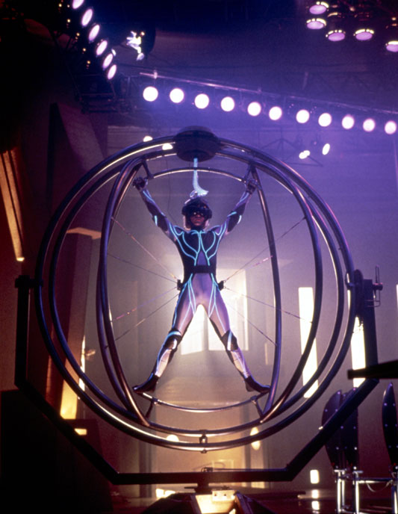
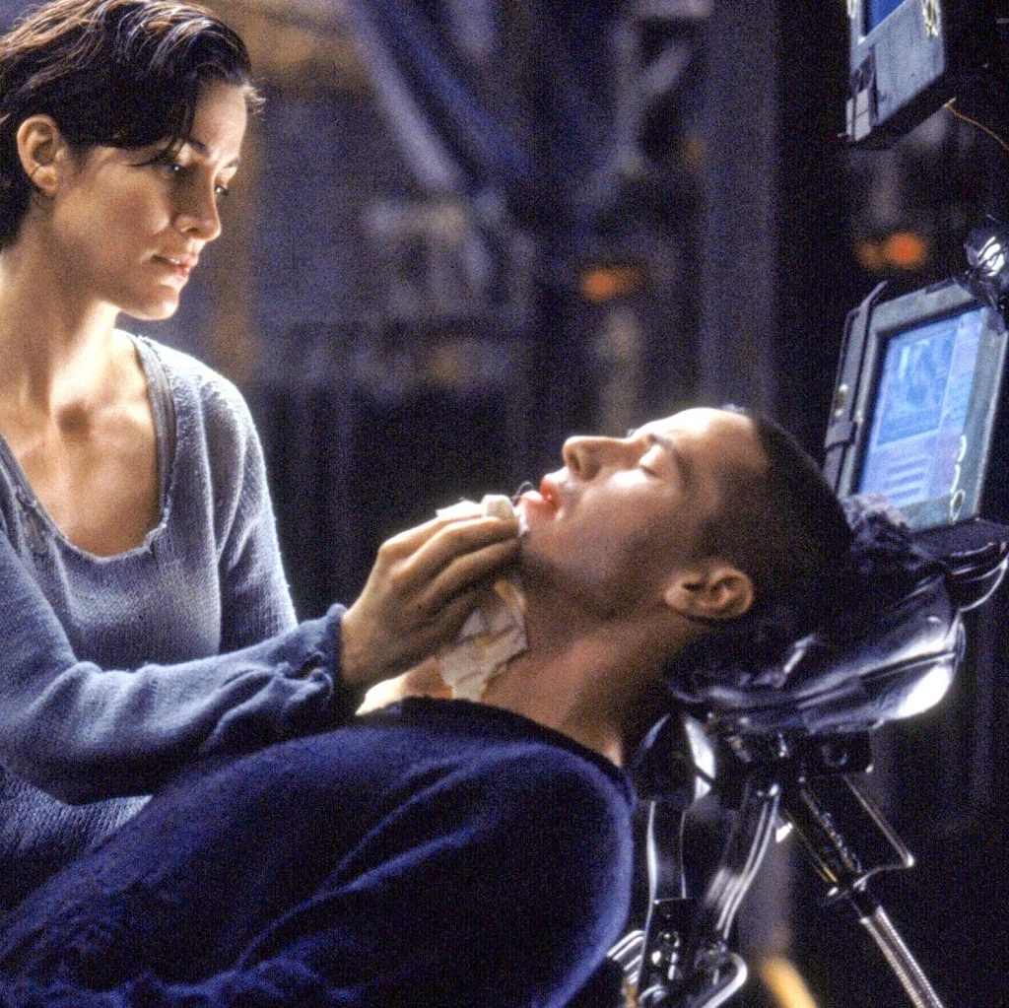
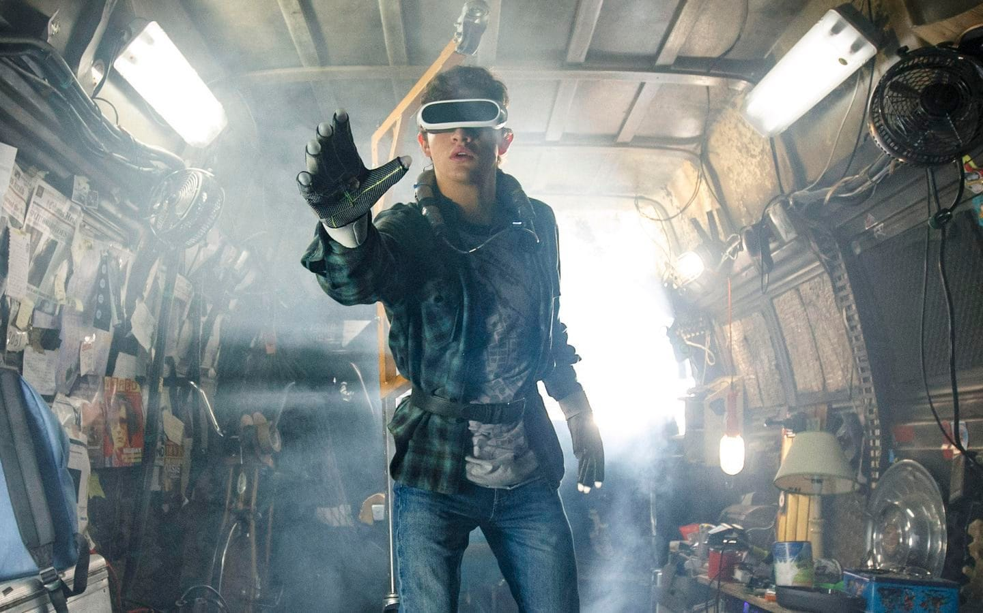
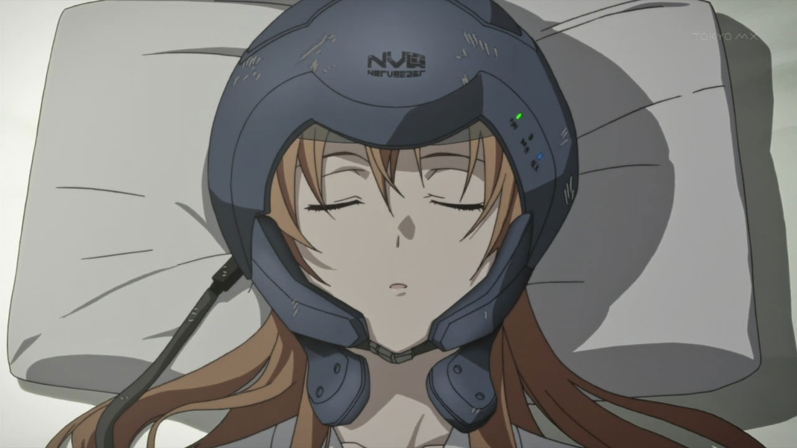
Lawnmower Man
The Matrix
Ready Player One
Sword Art Online

Slide 5
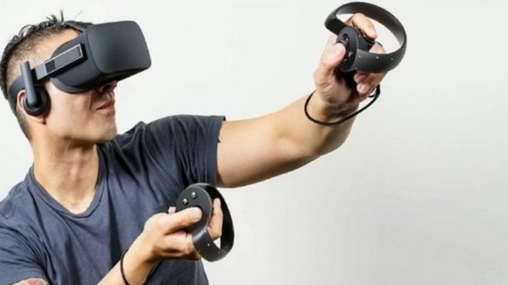
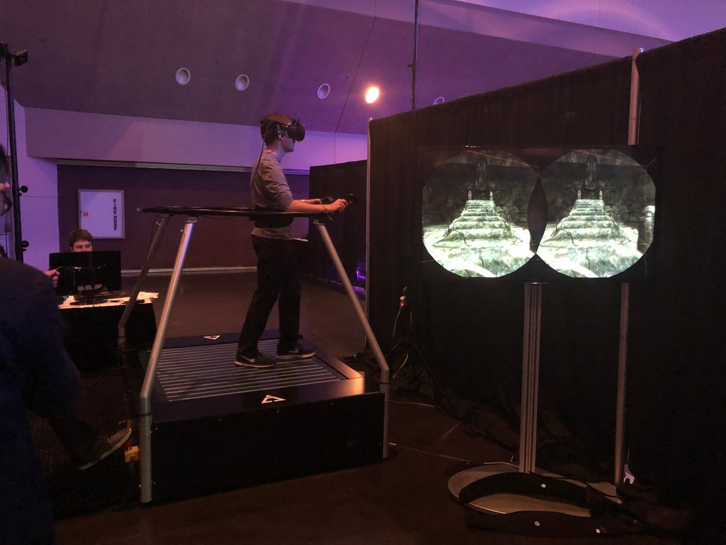
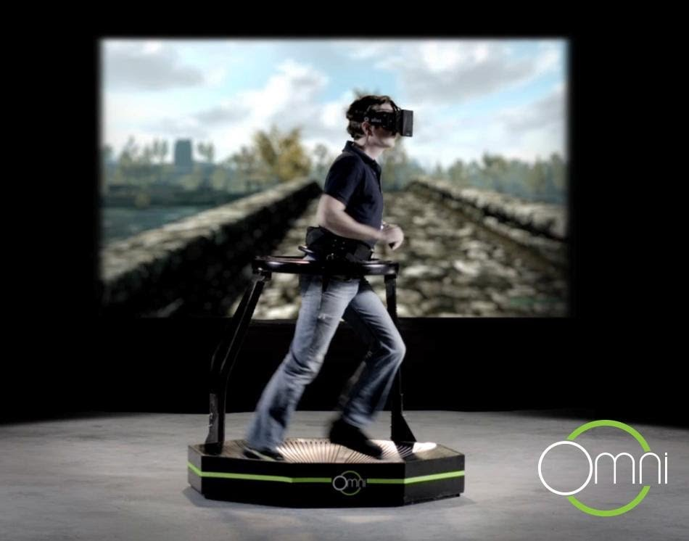
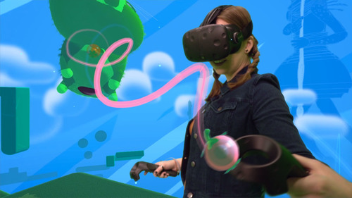
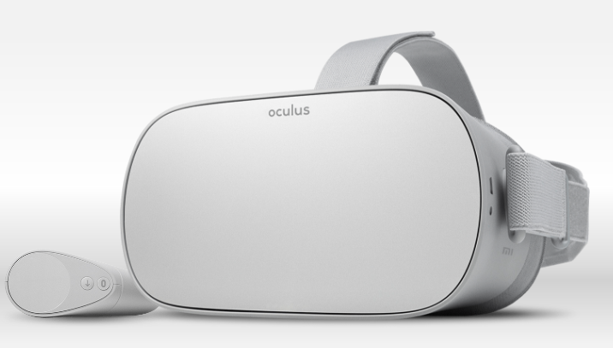
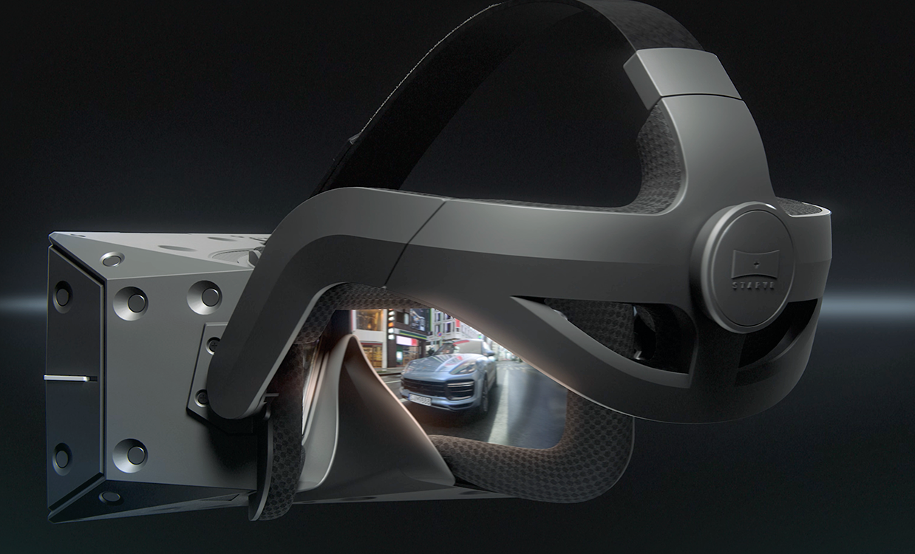
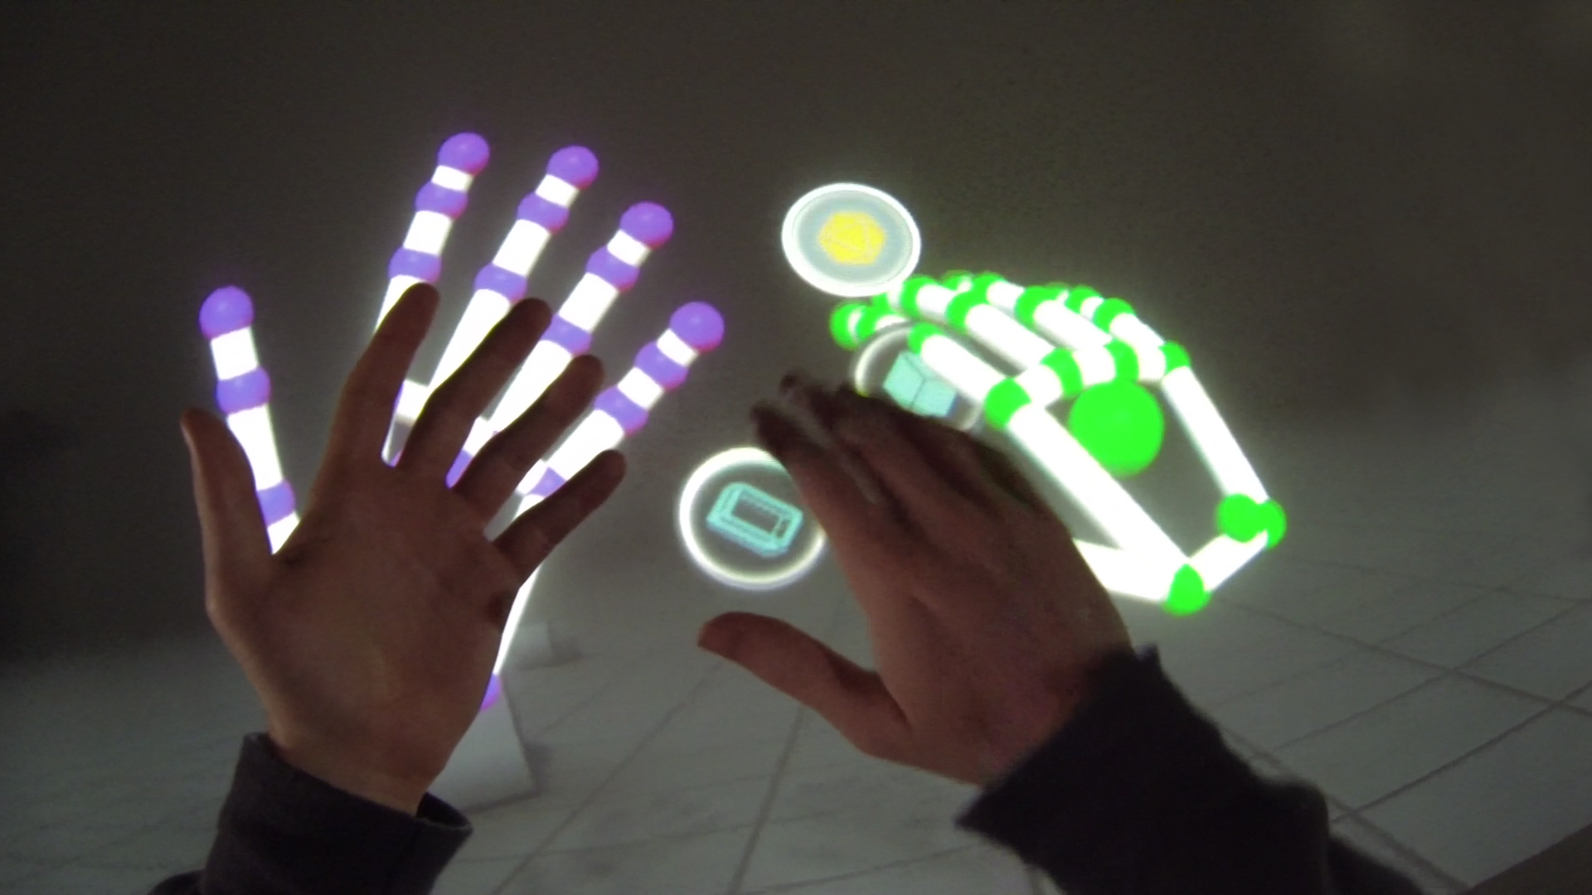
Oculus Rift
HTC Vive + Fantastic Contraption
Leap Motion, Blocks Demo
Infinadeck, Virtuix Omni
Oculus Go
Star VR “One”

Slide 6
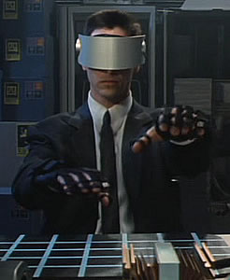
Overview
Goals and Challenges of AR and VR
Output:
Visuals
Audio
Haptics
Other Senses
Input:
Tracking
Locomotion
User Interface
Johnny Mnemonic (1995)

Slide 7
Definition of Virtual Reality
A Virtual Environment (VE) is any form of interactive simulation.
Virtual Reality (VR) describes a class of virtual environments which attempt to replicate reality to some degree.
A VE is immersive if it removes the user from real world stimuli.
Presence is the subconscious sensation of perceiving a virtual environment as real.
For example: your body will respond with fear to the scenario of being near a great virtual height when presence is achieved
Presence is the magic of VR
An interesting video of Michael Abrash discussing presence at a time before widespread VR headsets were available.

Slide 8
Goals of VR
VR attempts to fool your senses into telling you what you are perceiving is real.
VR engineering process for a given sensory system:
Understand the perceptual physiology and psychology behind the sensory system
Determine realism thresholds for the sensory system
Design hardware to interface with the sensory system
Design software to generate the appropriate signals
We will now look at a number of case studies of this approach applied to different sensory systems

Slide 9
If you get it right...

Slide 10
If you get it wrong…
Cybersickness:
Nausea
Dizzyness
Headache
Eye strain
Fatigue
Sweating
Leading theory attributes cybersickness to ‘Poison Theory’ – sensory systems don’t match up and so your body concludes it must be poisoned.

Slide 11
Output

Slide 12
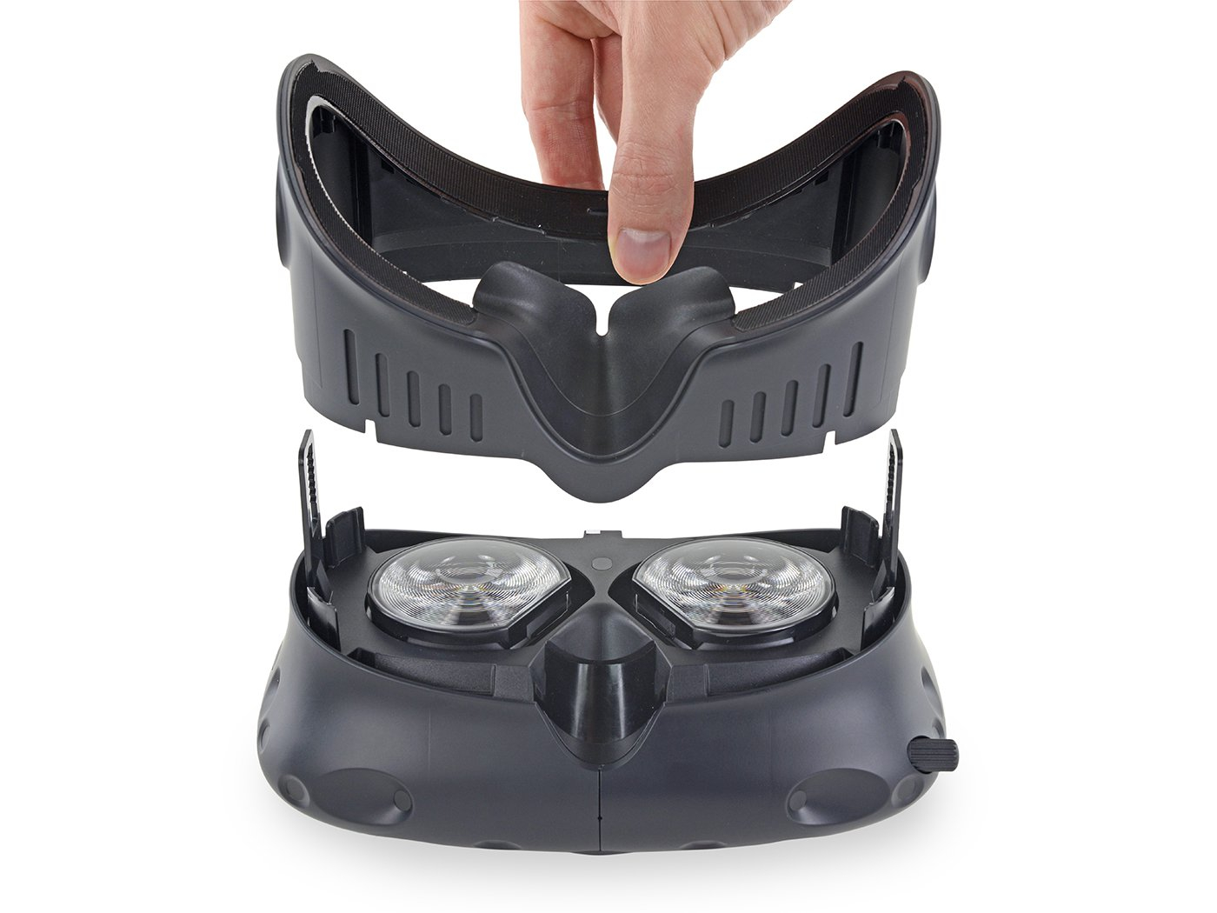
Visual Perception and Graphics

Slide 13
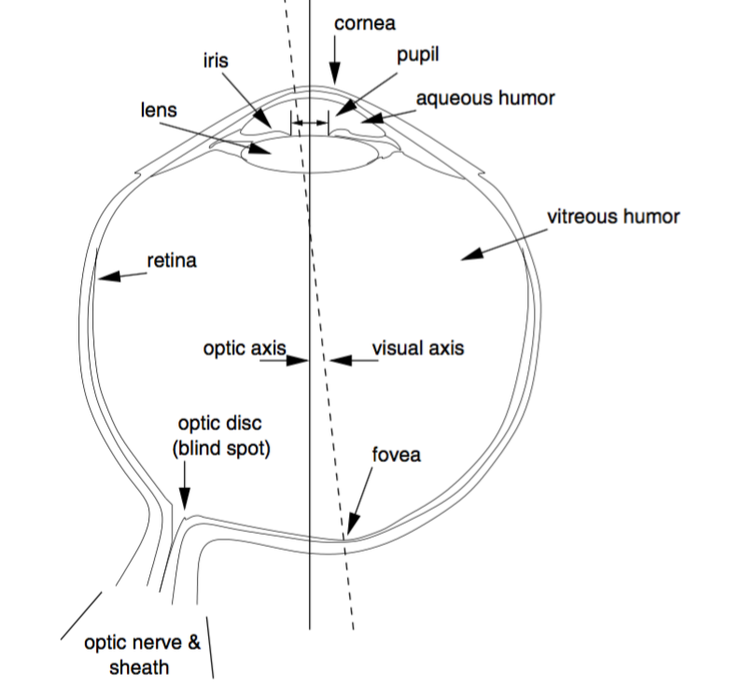
Human Visual System
Lens adaptively focuses light onto retina
Retina consists of 4 cell types
Rods
Cones corresponding to RGB
Central area fovea has high resolution – this is where detail is perceived
Eyes rotate to place images on fovea
Eyes have an effective resolution of 60 pixels per degree

Slide 14
Visual Depth Cues
Understanding the 3D world is vital to vision
Ordinal depth cue – determines object order only
Metric depth cue – gives an estimated distance to the object
Stereoscopic depth cues work through two slightly different images
Monoscopic depth cues require only one image

Slide 15
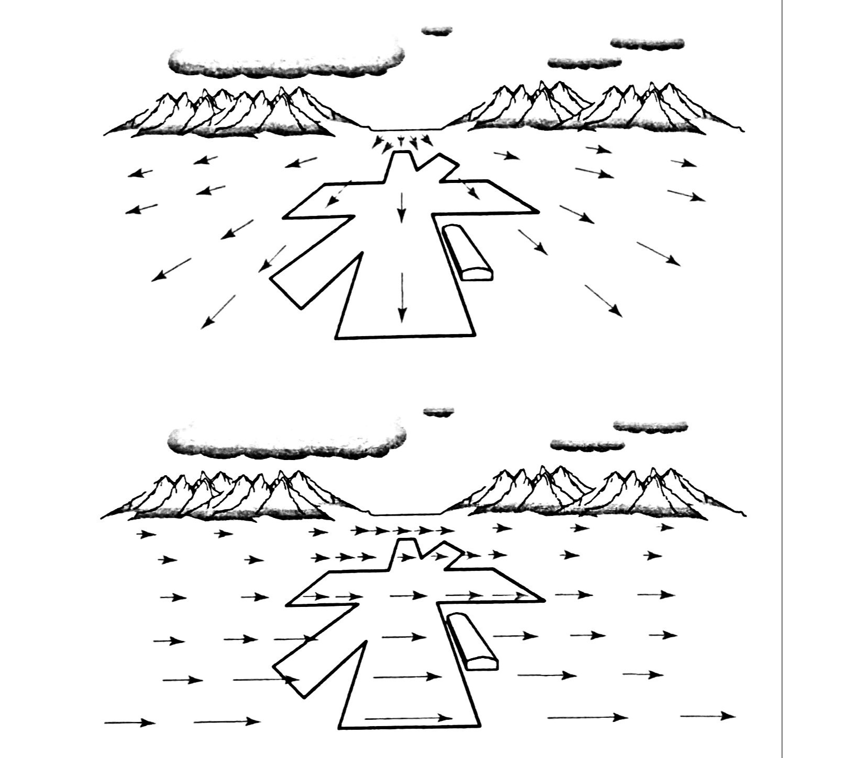
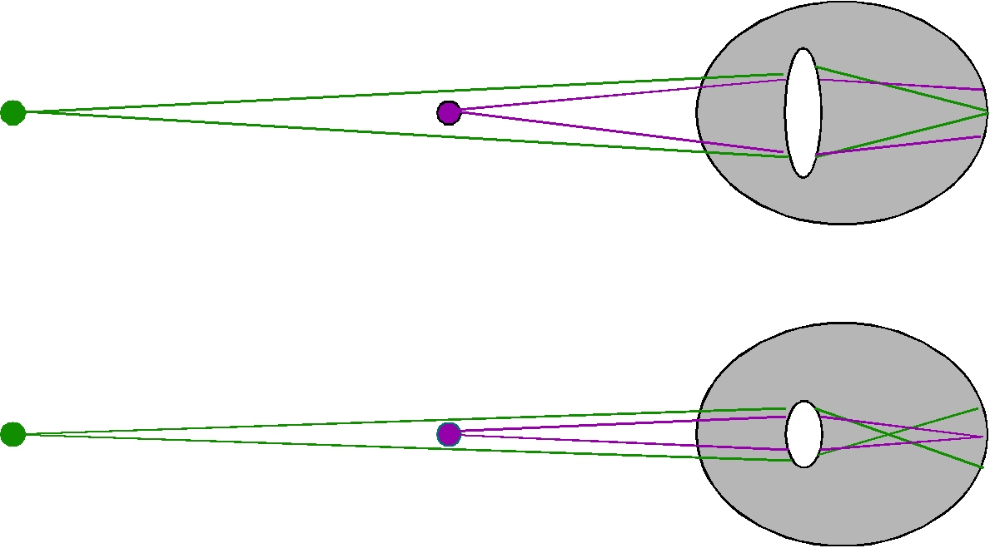
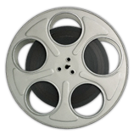
Monocular Depth Cues
Accommodation – the lens of the eye is strained to focus on near objects
Parallax – distant objects appear to move less than close objects

Slide 16

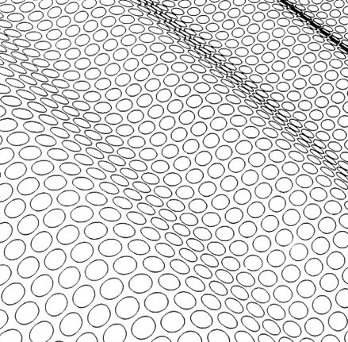
Monocular Depth Cues
Static and image cues include
Image size
Height in visual field
Blur
Fog / Atmospheric Perspective
Texture gradients
Shadows
Occlusion
Interposition (when one object occludes another, forming a “T”-shape edge)

Slide 17
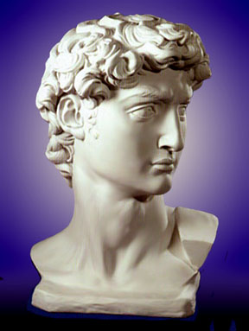
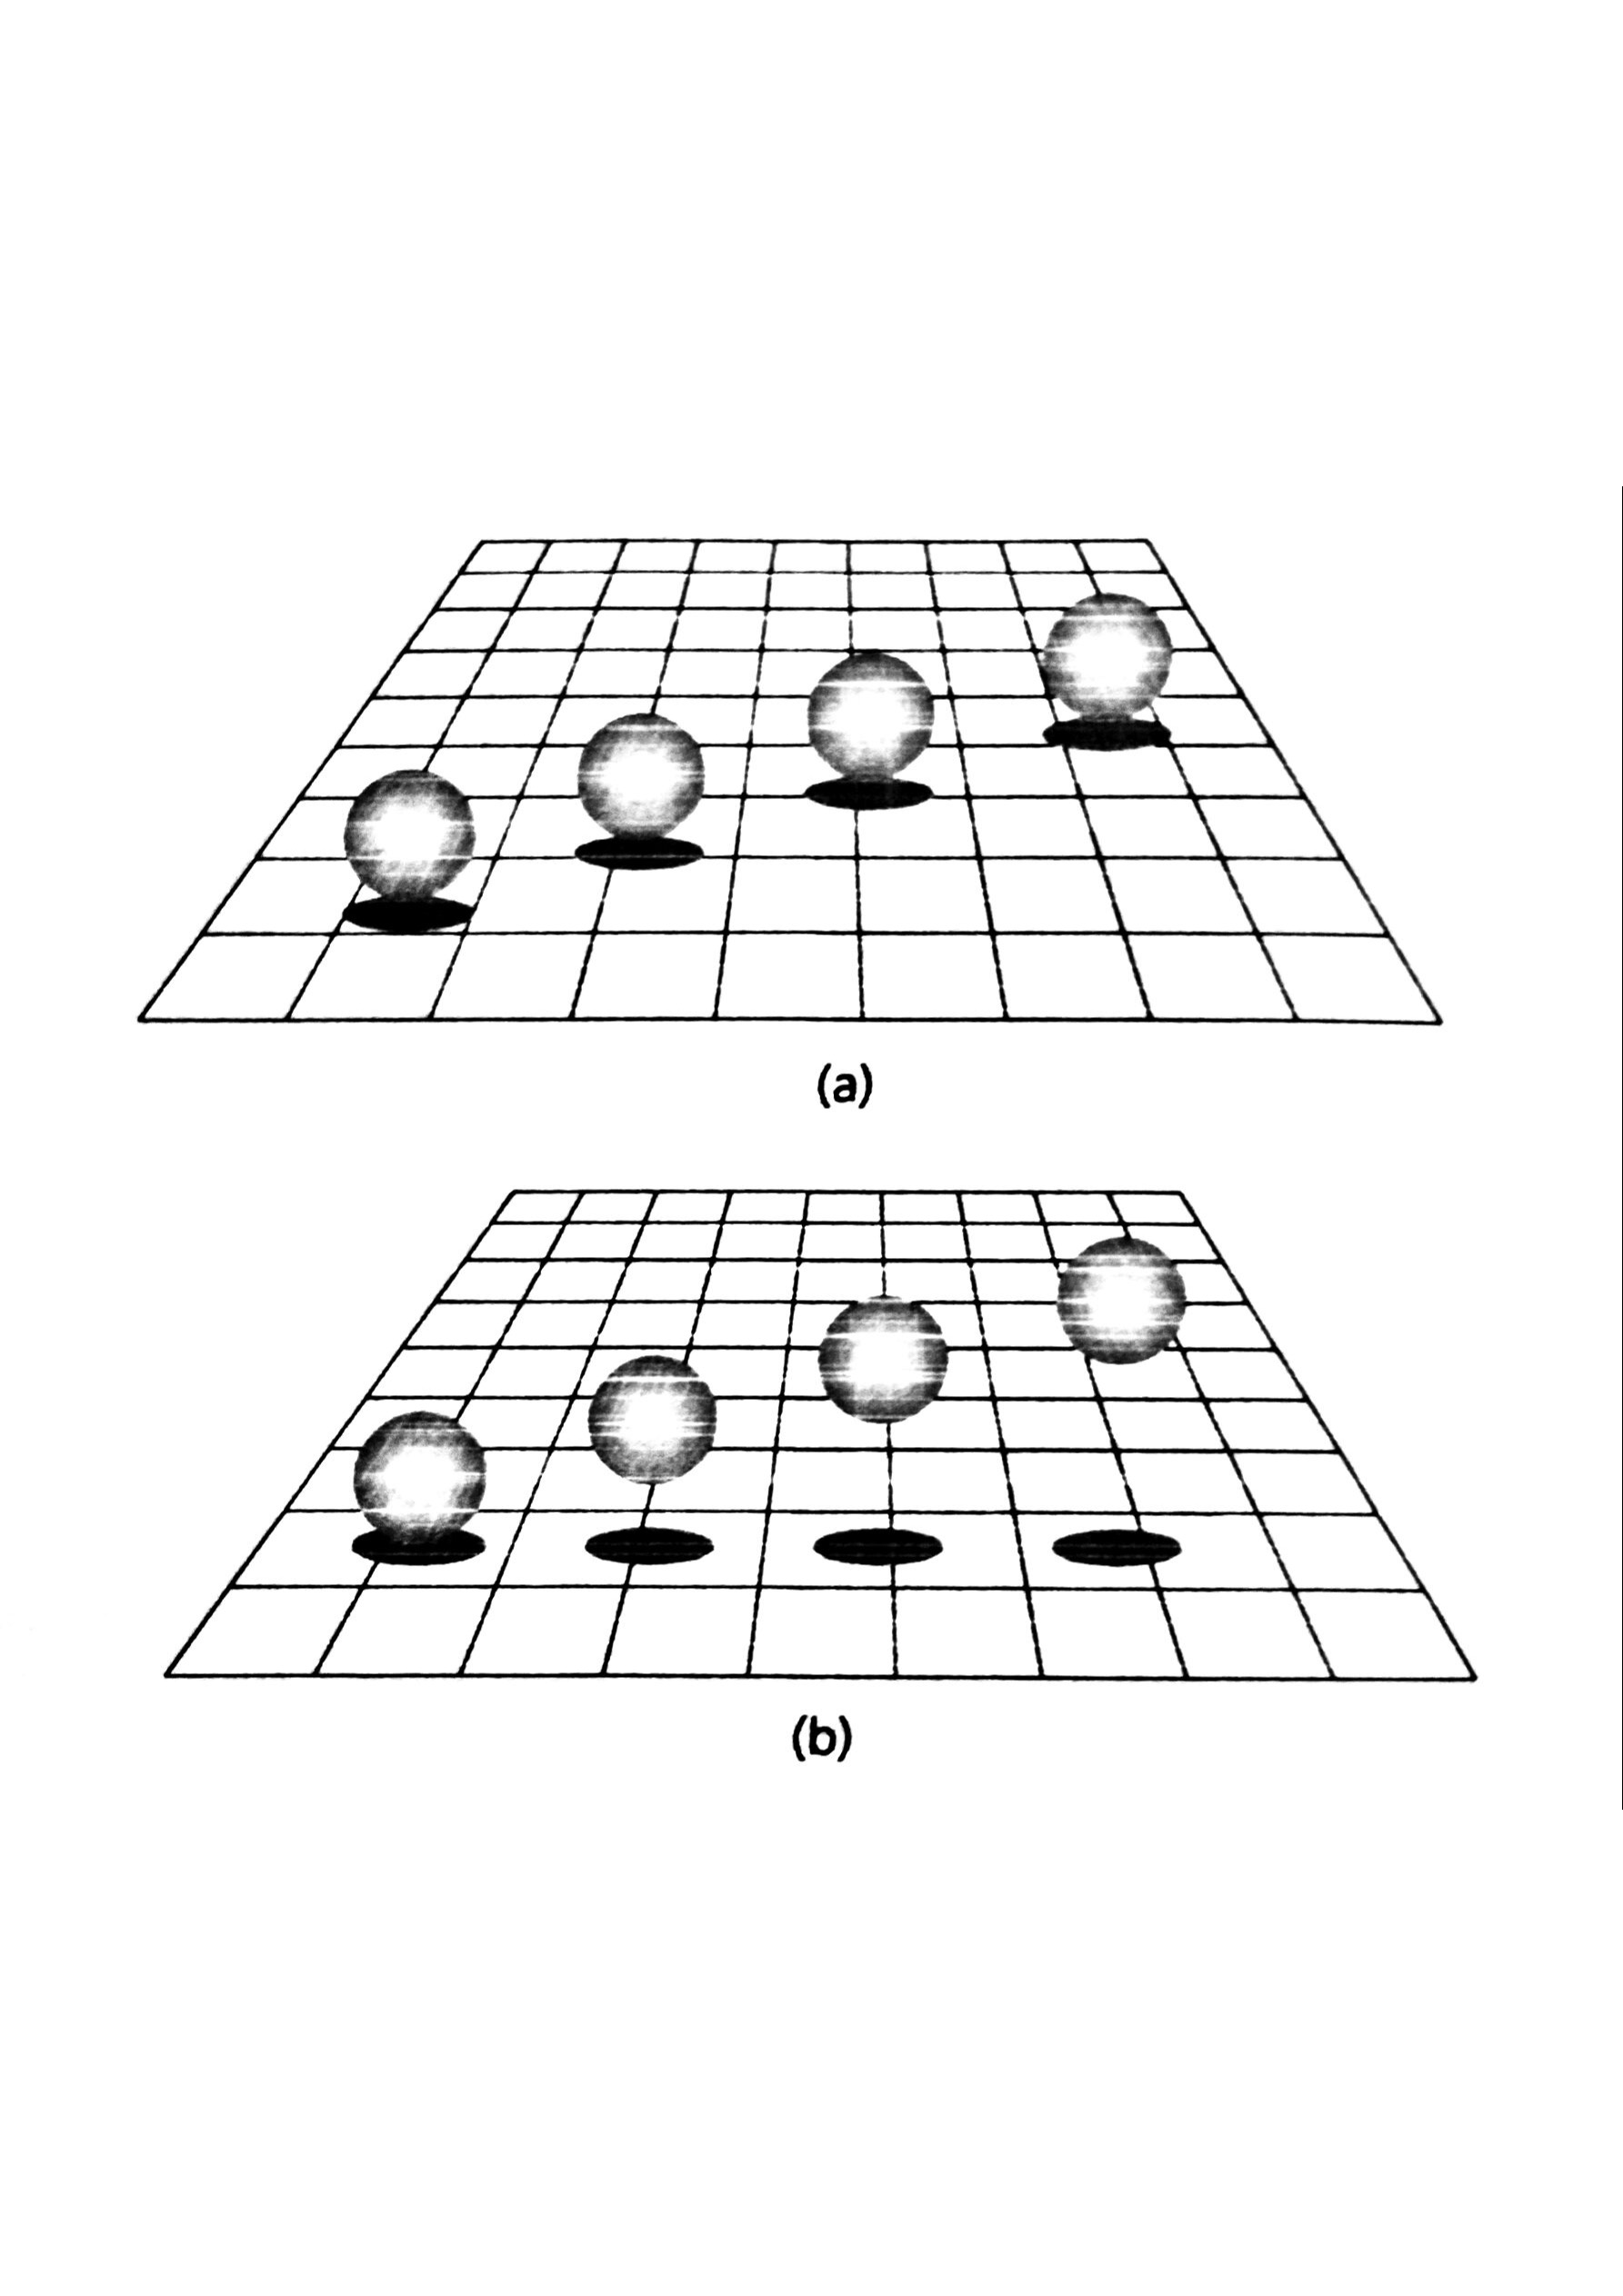

Slide 18
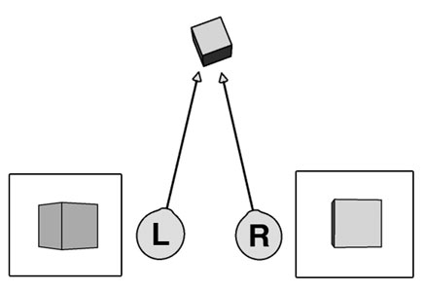
Stereoscopic Depth Cues
A depth cue is stereoscopic if two eyes are required to perceive it
Vergence – to view an object, the eyes must rotate an amount dependent on the distance to the object
Binocular Disparity – image differences between two images gives depth cues also

Slide 19
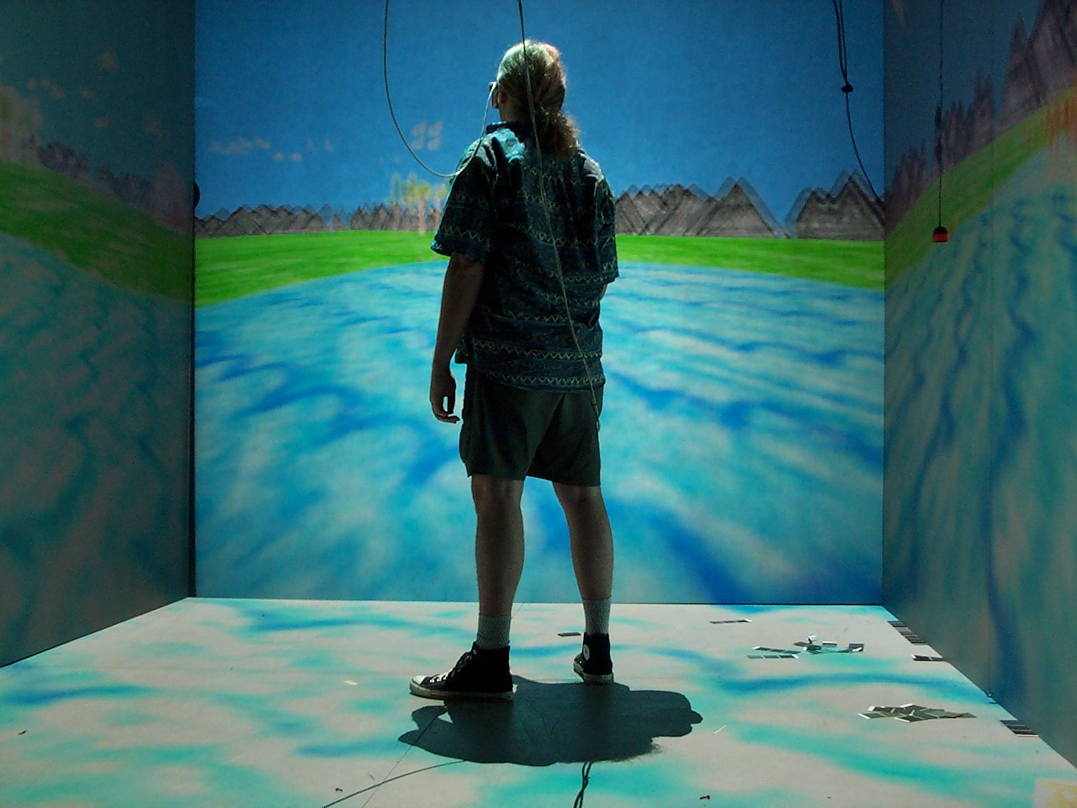
Visual VR Displays
Two common approaches for immersive displays:
Head Mounted Displays (HMD)
Cave Automatic Virtual Environment (CAVE)
Aim to reproduce:
Stereoscopic depth cues
Parallax depth cues
More difficult cues:
Accommodation

Slide 20
Common Concepts
Field of View (FOV) – the angle subtended by the limits of vision, usually measured horizontally
Field of Regard (FOR) – the angle through which the user can turn their head and still view the virtual environment
Angular Resolution – the number of pixels per unit angle. Typically this will vary depending on the system
Refresh Rate – the rate at which the display is updated
Tracking Rate – the rate at which tracking data is updated

Slide 21
Rendering Stereoscopic 3D
Rendering must be performed twice, once for each eye, with differing
View matrix
Projection matrix
Example Oculus Rift:
Stereo configuration (view and proj) is obtained from OVR SDK
Views are offset by inter-pupillary distance (IPD)
Projection skews slightly outward from center ray of head

Slide 22
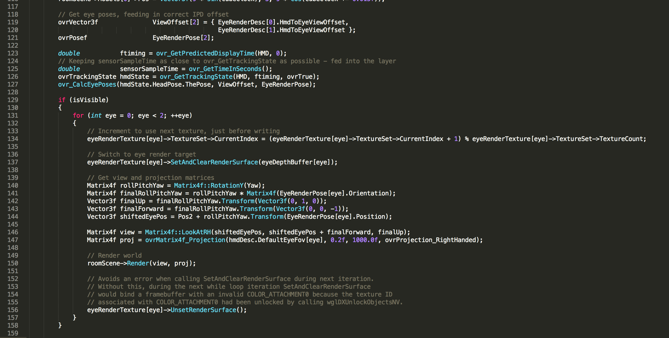
Rendering Example: Oculus Rift

Slide 23
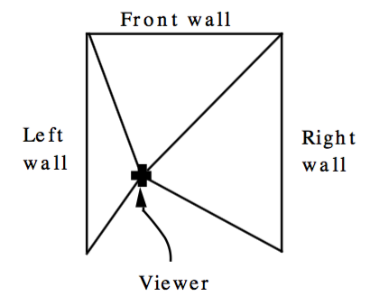
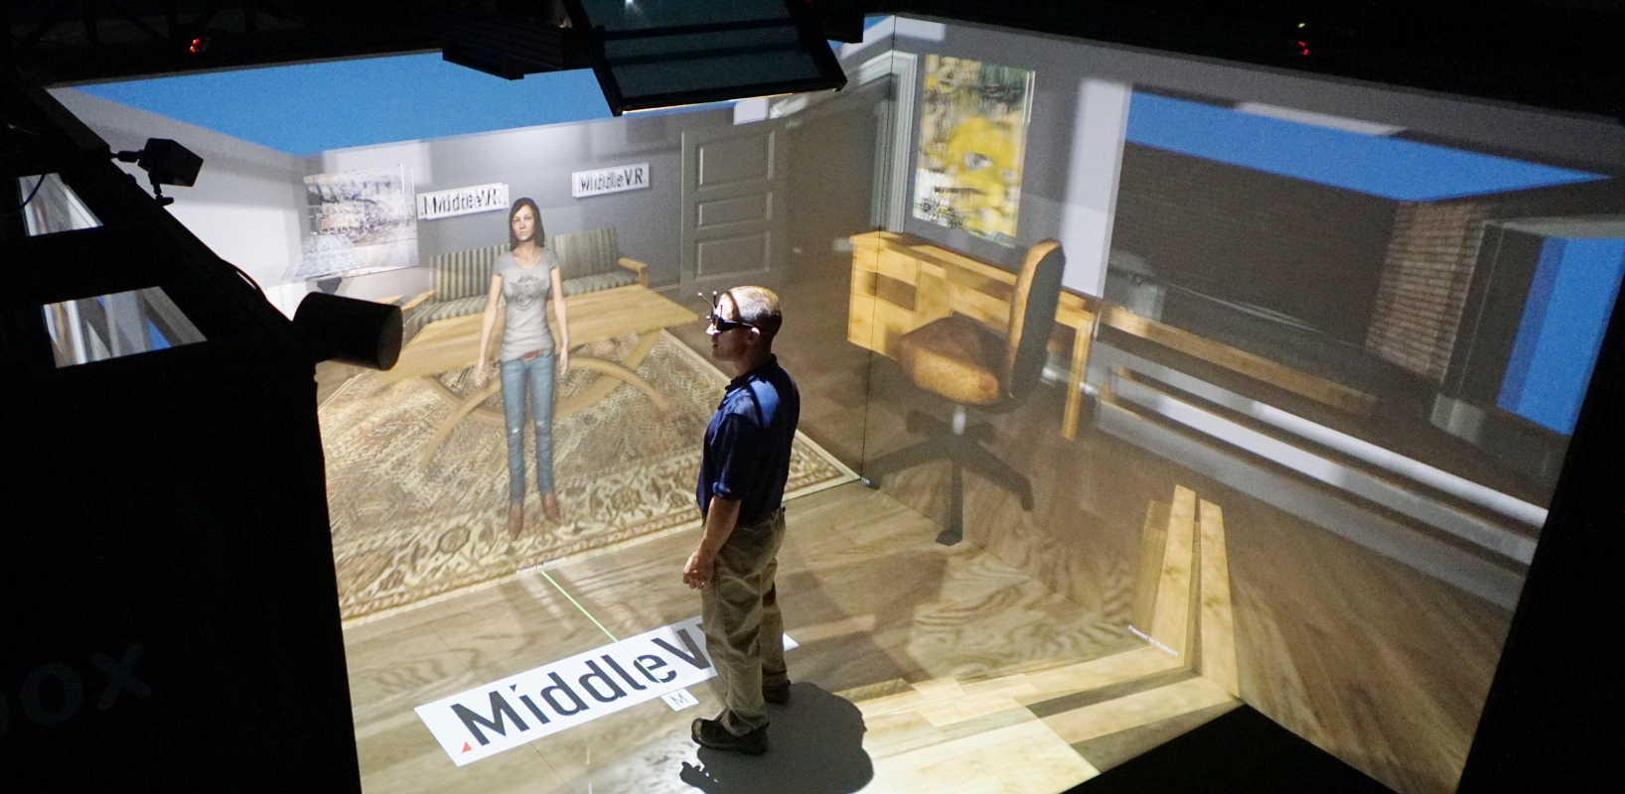
CAVEs
Consists of a set of screens surrounding the user
Cube arrangement of 1-6 screens
Half dome
Large single screen
Cylindrical
Head tracking is common, but not ubiquitous.
Multiplexed stereoscopy is usually used: temporal, polarization or a combination
Accommodation fixed at the position of the screen
Systems can support up to 6 simultaneous stereoscopic tracked views

Slide 24
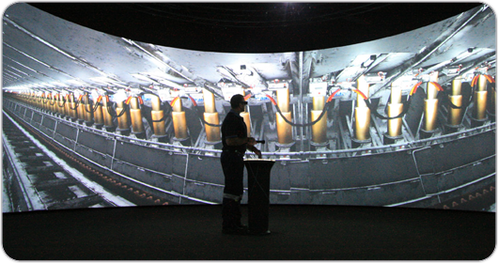
Rendering for a CAVE
View matrix – typically constant orientation with position at eye point
Projection matrix – where the magic happens
The projection matrix must be computed such that the edges of the view frustum passes through the corners of the screen relative to the user
Can include a non-linear rendering step if rendering to a dome, cylinder, etc.

Slide 25
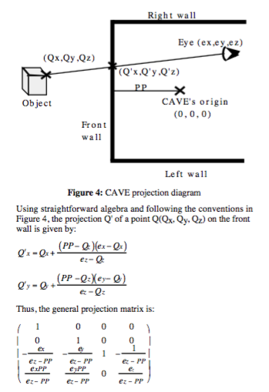
Projection Matrix for a Screen with Head Tracking
(THIS SLIDE NOT EXAMINABLE)
Off-axis projection

Slide 26
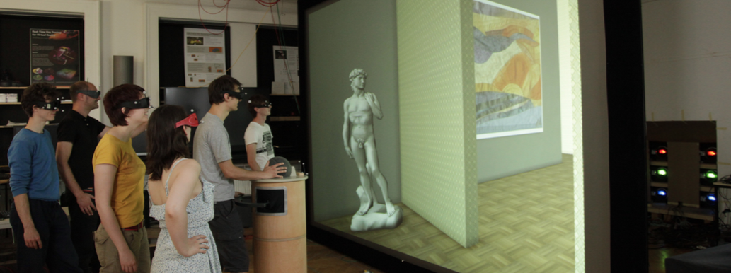
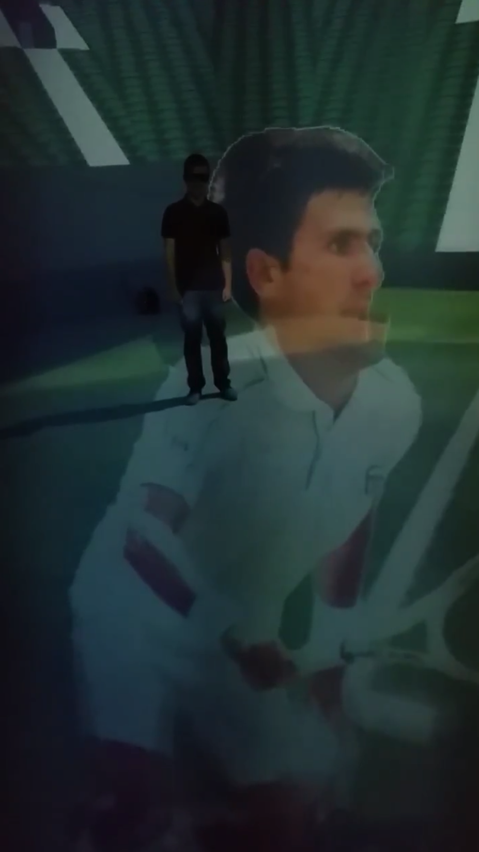
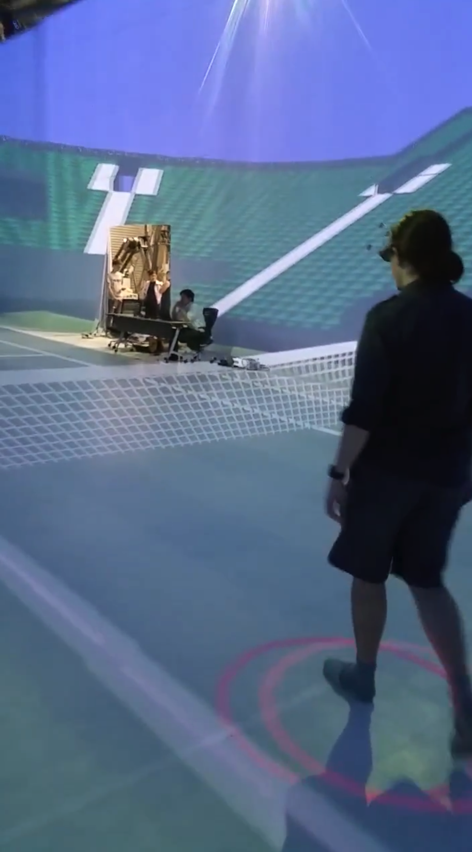
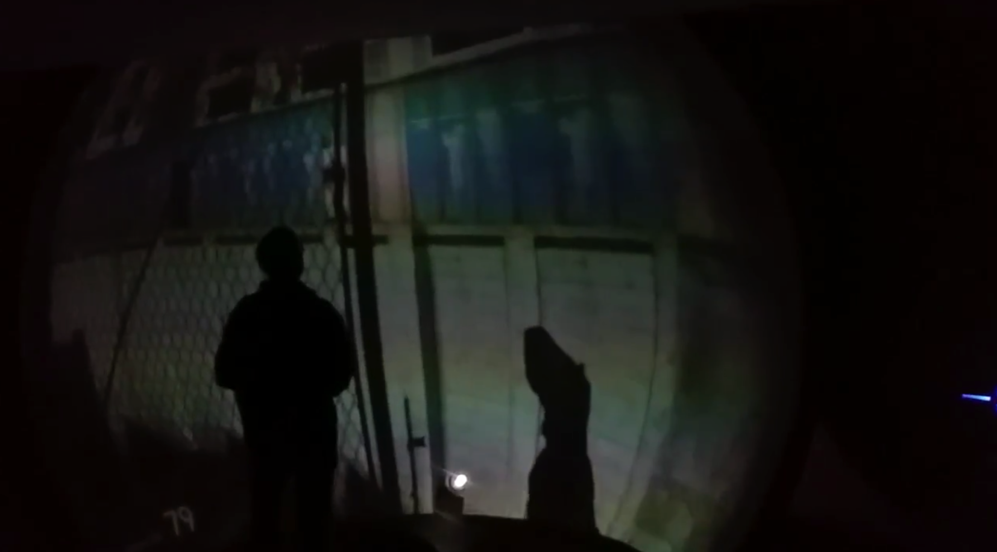
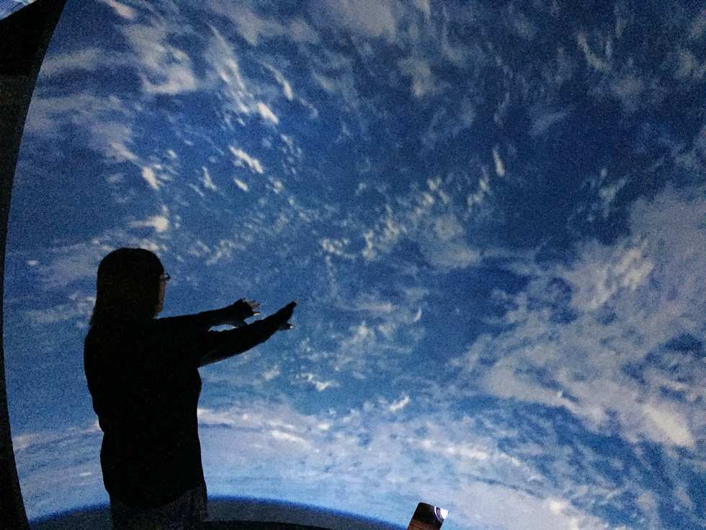
Some Examples
Kulik, A., Kunert, A., Beck, S., Reichel, R., Blach, R., Zink, A., & Froehlich, B. (2011). C1x6: A Stereoscopic Six-user Display for Co-located Collaboration in Shared Virtual Environments. In Proceedings of the 2011 SIGGRAPH Asia Conference (pp. 188:1–188:12). New York, NY, USA: ACM.
iDome, University of Newcastle, i3 Lab
Tsukuba University, Japan – Warehouse size cave

Slide 27
HMDs
Two screens with lenses for near-eye focus
The screens appear optically much larger and more distant
Stereoscopic depth cues
Accommodation is fixed at the plane of the virtual screen
Head tracking:
Orientation can be done with Inertial Measurement Unit (IMU; consists of MEMS Gyroscope, Accelerometer and optionally Magnetometer)
Position tracking:
Outside-in: external static sensors track objects (e.g. Rift, Vive, PSVR)
Inside-out: internal sensors track world (e.g. Hololens, Microsoft’s “Mixed Reality” Headsets, Oculus “Santa Cruz”)

Slide 28
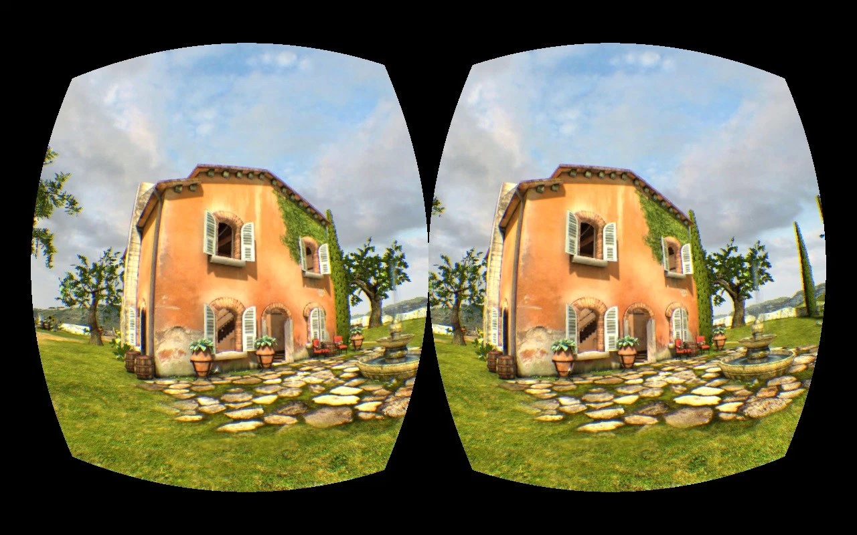
Rendering to HMDs
Projection matrix constant
View matrix varies with tracked head pose
Non-linear step often required for compensating for lens distortion – rendering more pixels than screen resolution

Slide 29
State of the Art HMD Rendering
At 90Hz, 2x1920x1080 resolution, to avoid motion sickness optimisation is important:
Asynchronous Time Warp / Asynchronous Space Warp – use latest tracking data with cheap prediction based on previous frames
Single pass stereo – render to both eyes with single draw call
Lens matched / Multi-res shading – don’t render pixels out of view and scale detail with lens correction warping
VR SLI – render one eye per graphics card simultaneously
Frontbuffer rendering – “chase the beam” – render directly to front buffer to remove latency associated with swapping buffers
Centered resolution – render lower detail in periphery of view

Slide 30
Screen Resolution vs. Angular Resolution
Average angular pixel density:
FOVx, FOVy = total field of view in the horizontal and vertical directions (degrees)
W,H = screen resolution width and height (pixels)
Δp = angular pixel density (pixels / degree)
Δθ = 1/Δp = angular resolution (smallest resolvable detail / angular distance between two adjacent pixels)

Slide 31
Temporal Super-Resolution
In a HMD:
Virtual objects move counter to head movement across the screen
Moving objects are sampled at different points over time
These details can be smaller than the resolution of the screen
This gives a perceived higher resolution during head movement

Slide 32
CAVE vs HMD
CAVE | HMD
Body presence Less motion sickness due to orientation tracking not required High FOV (up to full human FOV) Low FOR (depending on system) High cost Large space required Multi-user interaction can be supported by single display | Body presence requires extra tracking Motion sickness common in slow systems Smaller FOV (~100°) High FOR (completely immersive) Low cost Small space requirements Multi-user interaction requires additional HMDs
CAVE is typically considered the gold standard, but HMDs have become much more common over the last few years

Slide 33
VR Special Considerations
Rendering VR environments must be fast (60-90Hz) and common graphical tricks break down.
Special considerations need to be made for
Level of detail of objects which can be inspected closely
Normal mapping is less effective
Anti-aliasing is vital for low resolution screens
Optimisation and frame timing
Interaction
Comfortable viewing – minimise virtual world movement

Slide 34
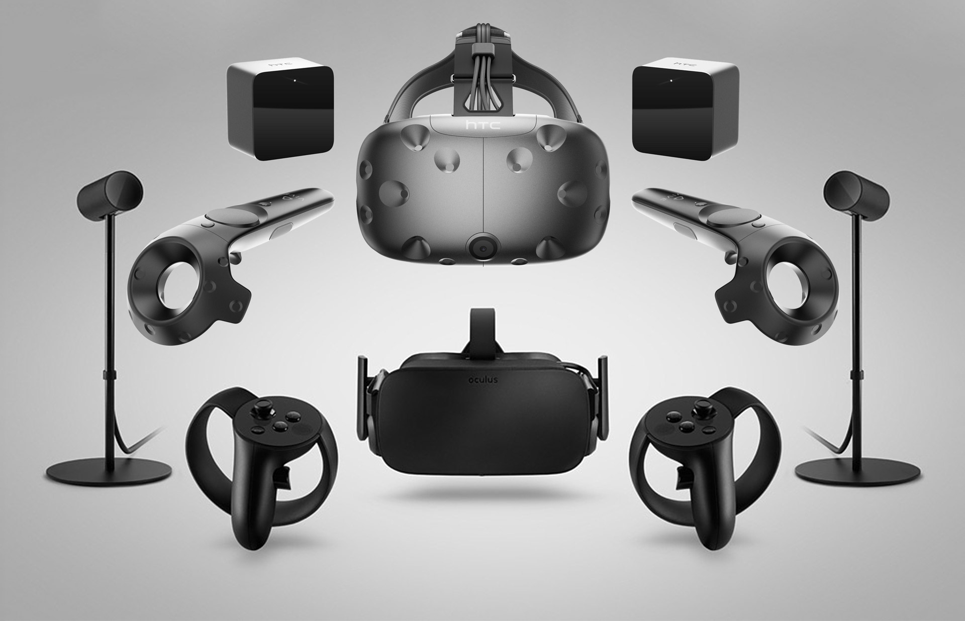
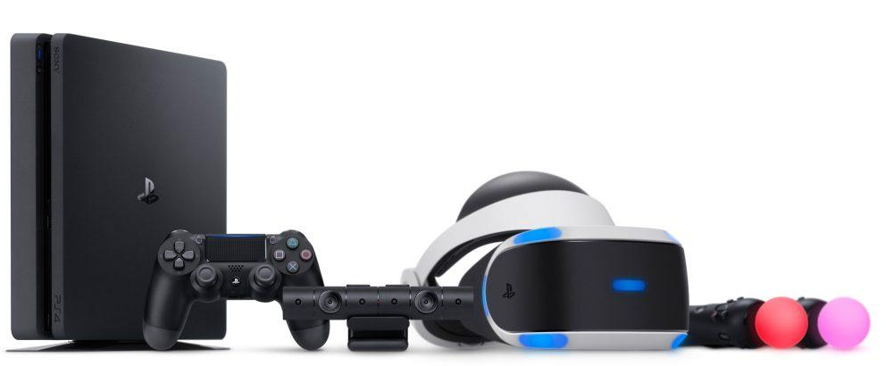
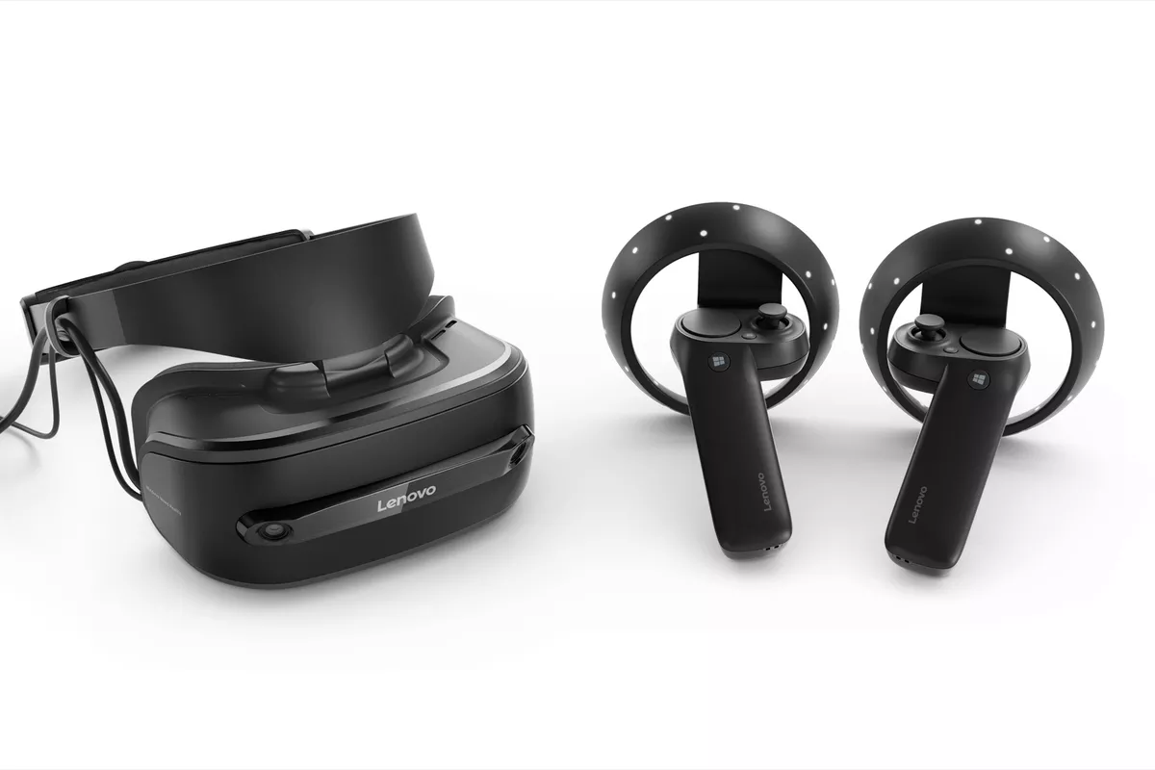
Towards a Standard Platform for Consumer VR
Standard hardware trends emerging:
Oculus Rift + Touch Controllers
Vive + Wands
PSVR + PS Move Controllers
Windows Mixed Reality with Controllers
Product categories:
Tethered (to PC or console)
Mobile Phone Powered (e.g. Samsung Gear VR, Google Daydream)
Standalone – coming soon (e.g. Oculus Go)
Top to bottom: HTC Vive, Oculus Rift, PSVR, Windows MXR

Slide 35
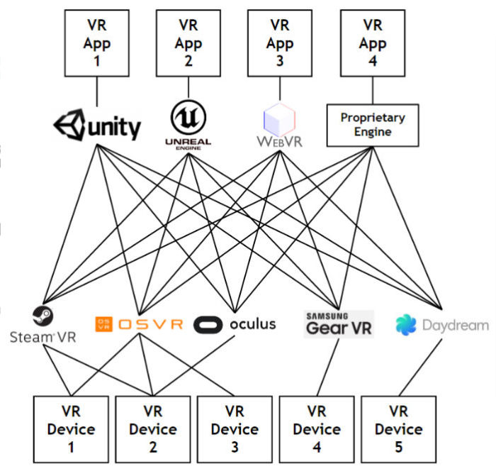
Towards a Standard Software Platform for VR
Current platforms:
Oculus Home – best for Rift and Touch Controllers, many exclusive games. Doesn’t officially support other headsets, but 3rd party software exists (ReVive)
SteamVR / OpenVR – best for Vive. Not actually OPEN – it is owned by steam and the code is not open source. However, it does support many different types of headsets, including Rift and Windows MR. Steam wants to maintain its monopoly on software
Windows Mixed reality platform
We want a truly open and impartial platform so that any hardware can work with any software platform
Solution: OpenXR

Slide 36
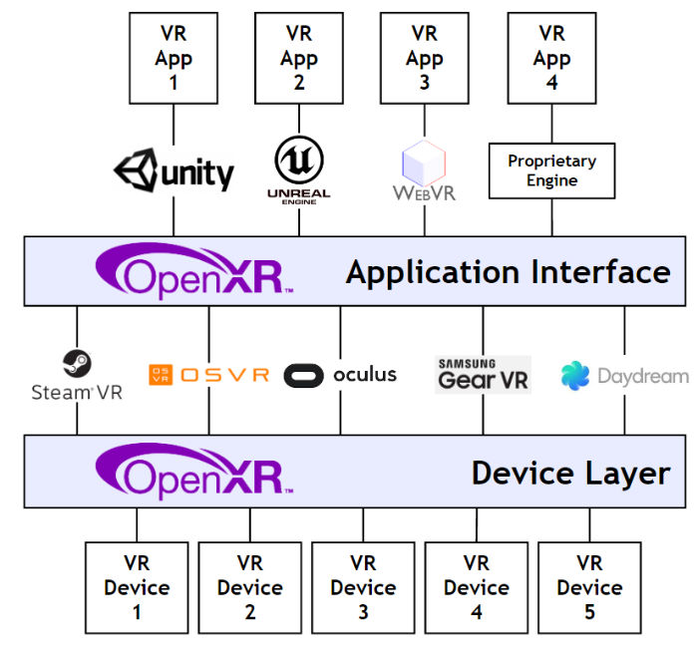
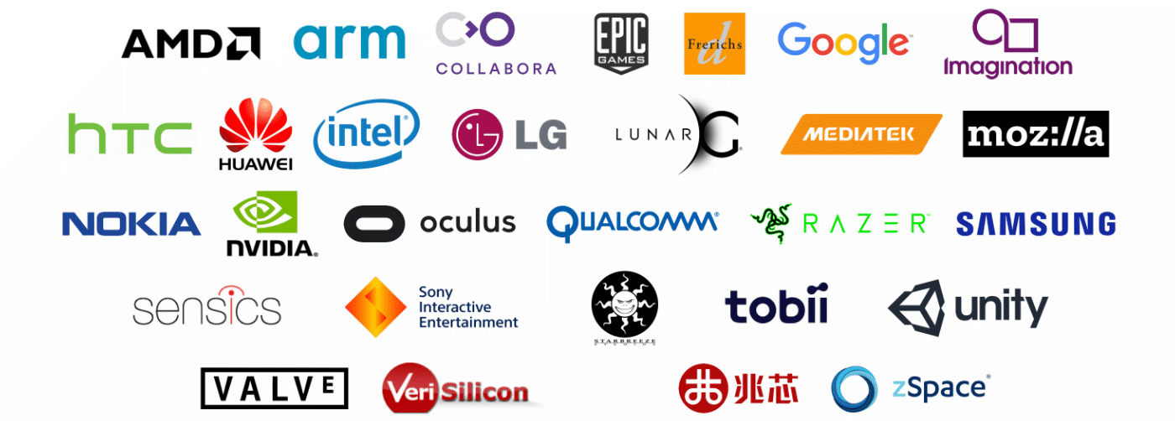
OpenXR
Similar to OpenGL
Also by Kronos Group
Only at the beginning of implementation of the standard (as of Oct 2017)

Slide 37
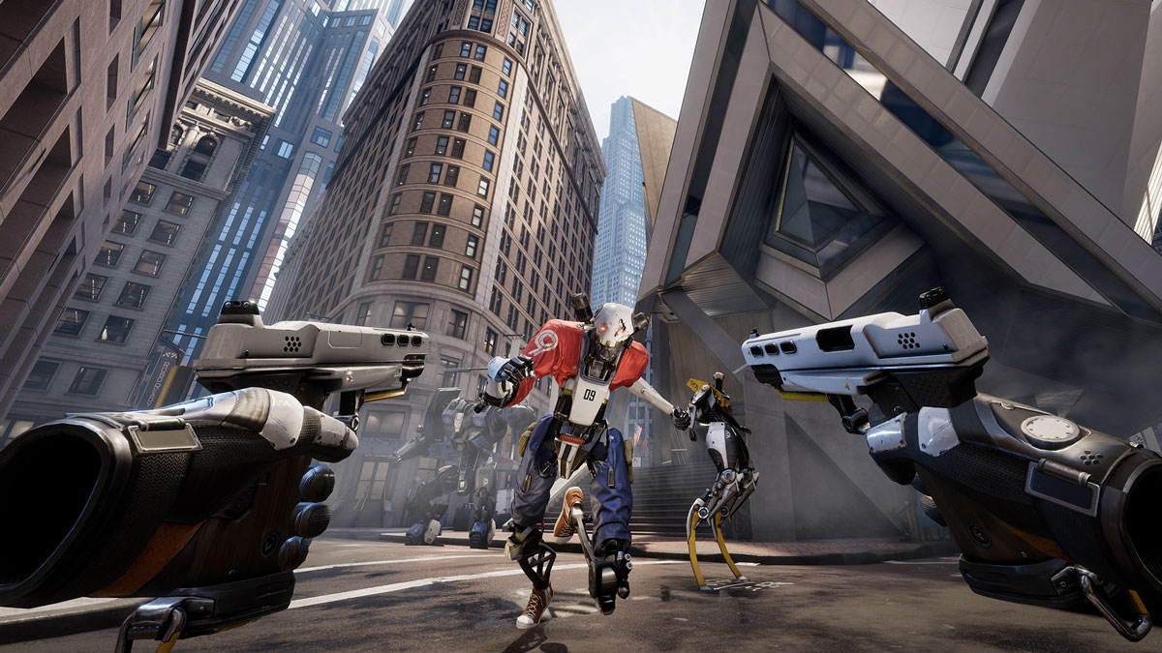
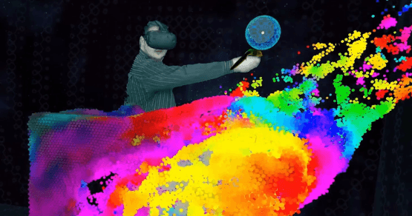
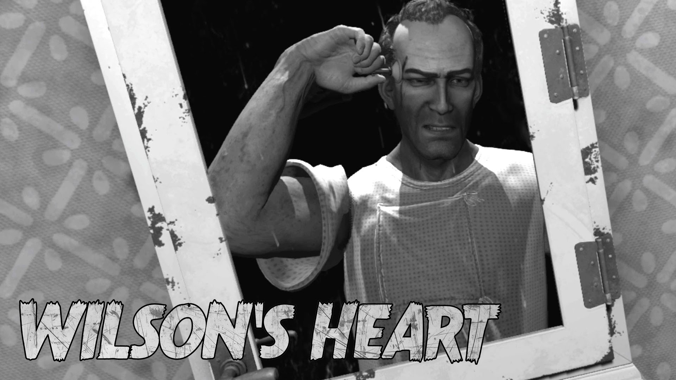
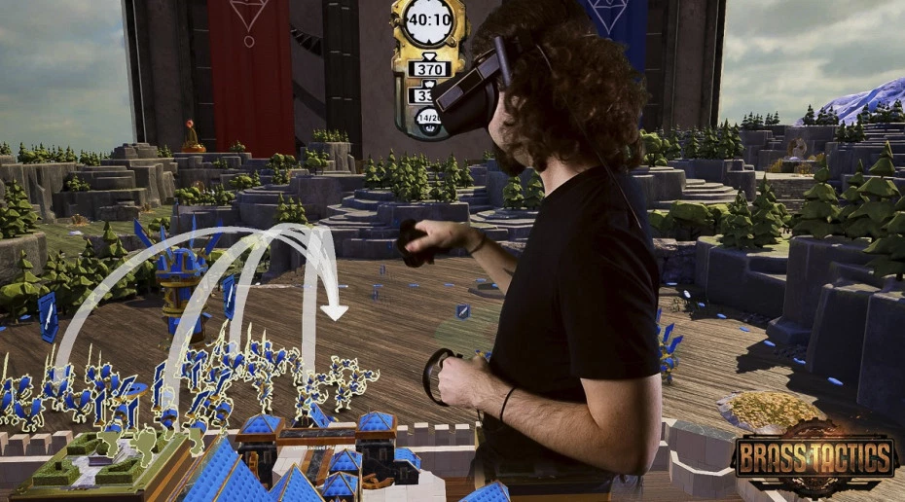
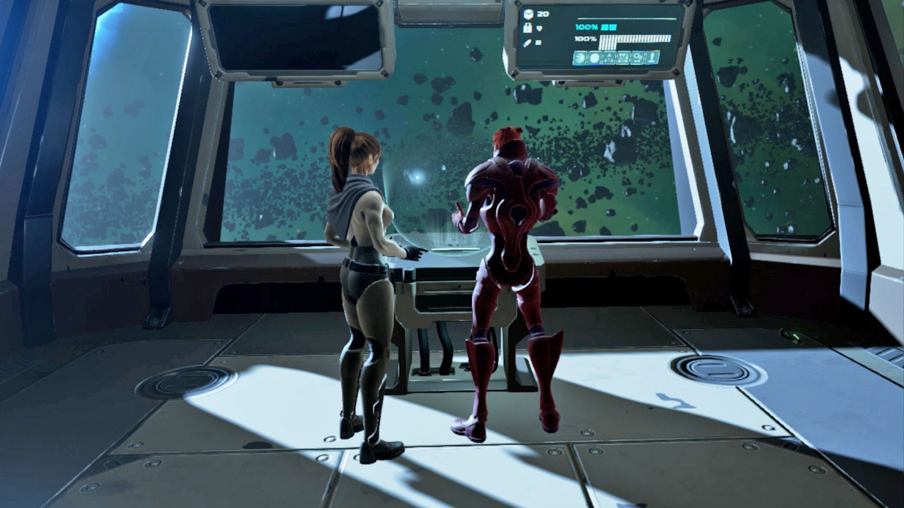
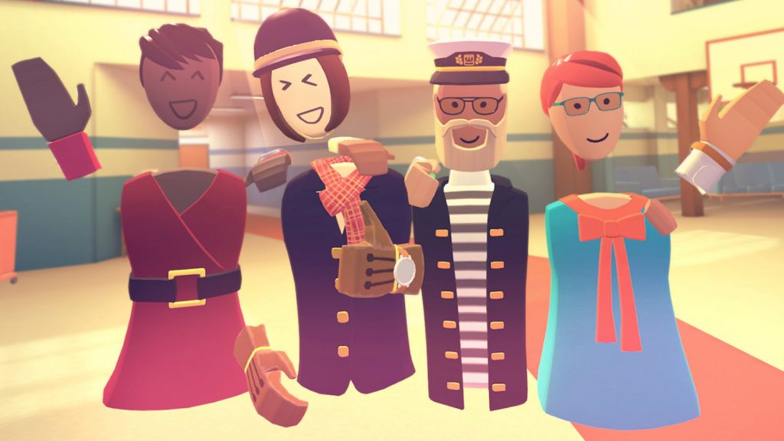
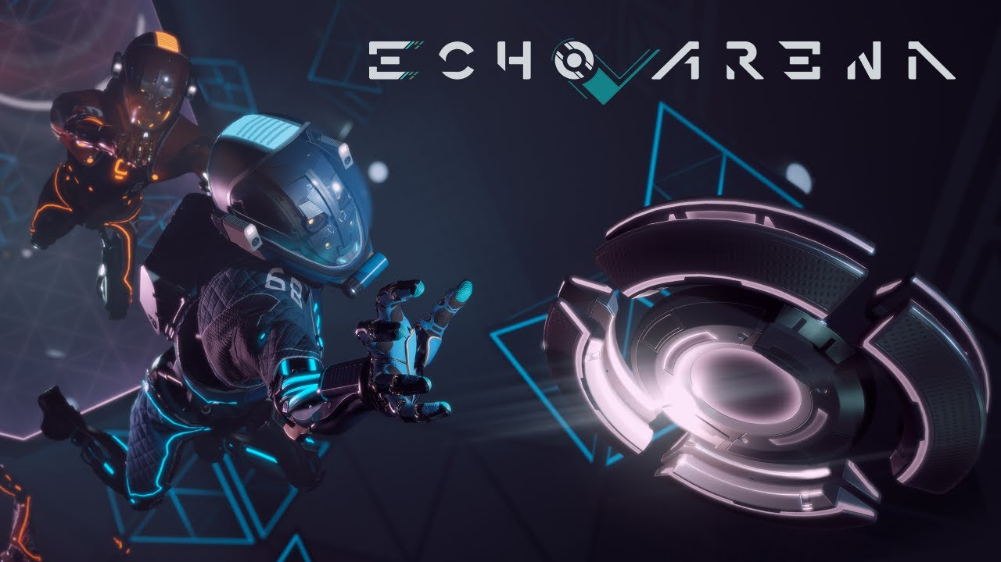

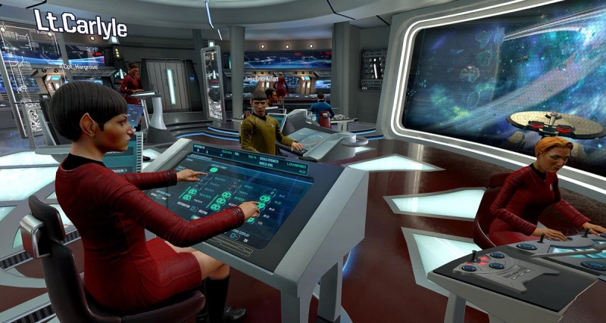
Examples of Software

Slide 38
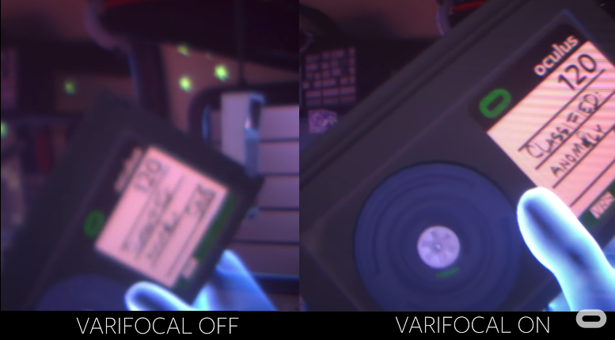
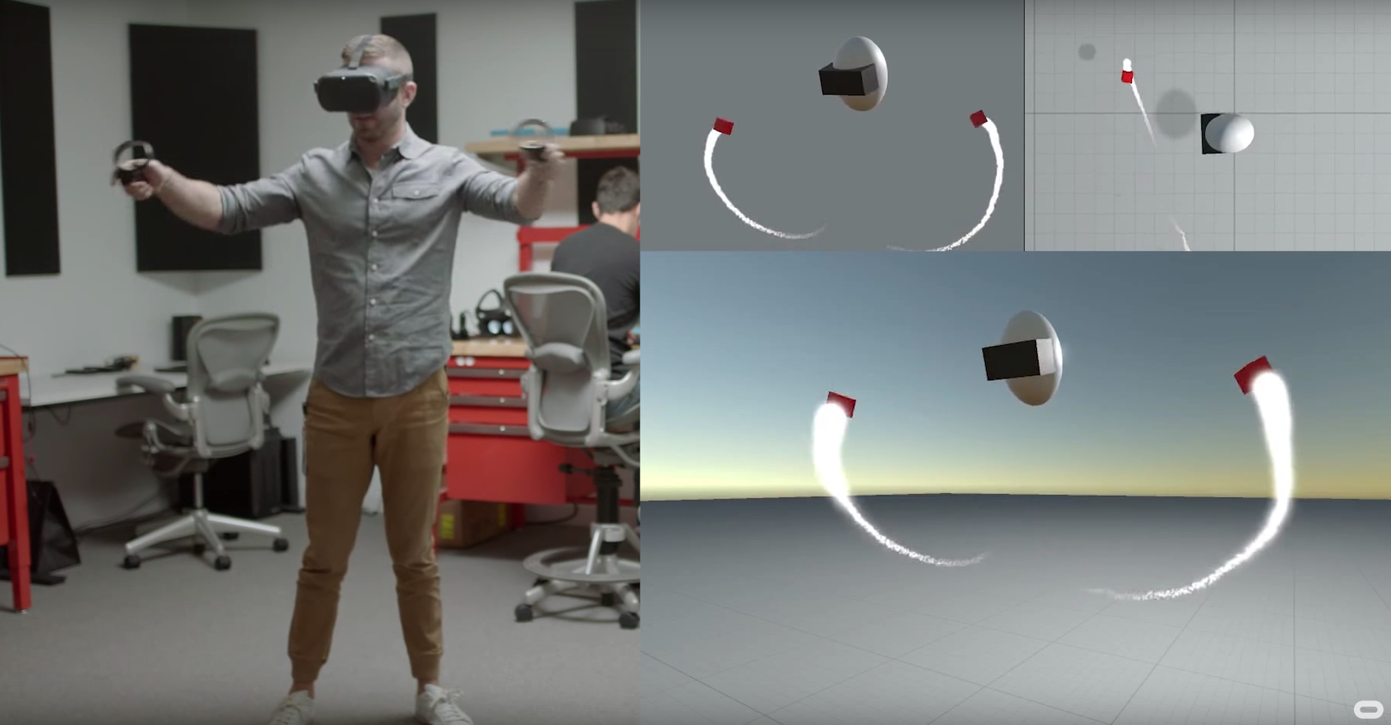
Future of HMDs
Larger FOV / Higher resolution
Eye Tracking
Foveated Rendering
Active Accommodation
Inside out tracking
Hand-tracking improvements
Tethered – E.g. Oculus “Half-Dome” Prototype
(active accommodation, eye tracking, large 140 FOV with same form factor as Rift)
Mobile – E.g. Oculus “Santa Cruz” Prototype
(inside out tracking, similar to current tethered devices but no PC required)
Oculus “Half Dome”
Oculus “Santa Cruz”

Slide 39
Augmented Reality
Screen based – no head tracking / window-projection means objects look added in post production (e.g. ARkit from Apple, ARCore from Google)
Passthrough to a VR headset – high latency, but can draw opacity and darkness
Hololens / Magic Leap – overlay artificial images with real
Challenges :
Real time tracking and environment mapping
Drawing realistic objects (lighting matching environment, drawing opacity and darkness, illuminating real objects with virtual light)
Better specs needed for mass adoption – FOV, battery life, comfort, graphical power, mapping range
Interaction – comfortable, socially acceptable, efficient
Realistic accommodation cues (solved by Magic Leap? Not yet!)

Slide 40
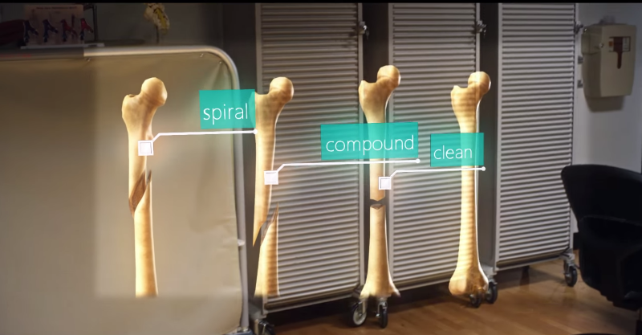

Magic Leap
Microsoft Hololens

Slide 41

Audio in Virtual Reality

Slide 42

Human Audio Perception
Sound is a pressure wave in the air
Air vibrates the tympanic membrane, or ear drum, a membrane across the ear canal
The vibrations are transmitted through three small bones to the cochlea
The bones perform impedance matching between air a fluid media by increasing pressure

Slide 43

Inner Ear
Consists of several fluid-filled cavities
Cochlea:
Senses sound
Coiled tube
Semicircular canals:
3 orthogonal looped canals
Otolith organs:
Contain hairs for sensing motion
One organ for angular velocity attached to Semicircular canals
One for linear acceleration
Mather, G. (2009). Foundations of sensation and perception (2nd ed., Vol. 10). Psychology Press. Retrieved from http://tandfbis.s3.amazonaws.com/rt-media/pp/common/sample-chapters/9781841696997.pdf

Slide 44

Cochlea
Bones connect to the Cochlea at the oval window
Uncoiled, the Cochlea is actually two parallel tubes connected at the end opposite to the oval window
The membrane between the two tubes is called the Basilar membrane
Sound produces waves in the Basilar membrane
Varying stiffness of the Basilar membrane means different frequency waves peak in amplitude at different points along the membrane
Mather, G. (2009). Foundations of sensation and perception (2nd ed., Vol. 10). Psychology Press. Retrieved from http://tandfbis.s3.amazonaws.com/rt-media/pp/common/sample-chapters/9781841696997.pdf

Slide 45

Frequency Perception
Hairs in the Basilar membrane then sense the sound
Sound frequency is distinguished based on where in the membrane the sound resonates
Effectively performs a (pseudo-) Fourier transform!
Mather, G. (2009). Foundations of sensation and perception (2nd ed., Vol. 10). Psychology Press. Retrieved from http://tandfbis.s3.amazonaws.com/rt-media/pp/common/sample-chapters/9781841696997.pdf

Slide 46
Audio Localisation
Interaural differences distinguish the horizontal plane:
Time of arrival difference
Sound magnitude difference
Changes with head movement can distinguish 3D location
Without head movement, 3D localisation still very good due to reflection, refraction and attenuation by:
Outer ear
Head and shoulders
Environment

Slide 47


Approaches to Audio
Headphones:
Two speakers close to ears, worn on head
Advantages: with head tracking, very immersive 3D audio can be synthesized, easy set up, cheap
Disadvantage: requires user to wear them, single user, blocks out real world (depending on design e.g. bone conduction headphones)
Speakers:
One or more speakers fixed in the environment
Advantages: does not contact user, multi-user
Disadvantages: sound field synthesis needed for immersive 3D audio – many speakers required with complex set up

Slide 48
Audio Problem Domains
Sonification:
Sounds within games usually pre-recorded and produced by Foley artist
Can we synthesize realistic sounds in real time?
Propagation:
Sound waves propagate much like light, with reflection, refraction, diffraction, interference and attenuation
Can we link sounds to the virtual environment realistically?
Spatialisation
Assuming we have a computed the local sound field as above, how do we display this with the available hardware?

Slide 49


Sonification
Typically involves pre-computing the object deformation frequency modes using Finite Element Method:
Mesh is decomposed into many simple volume ‘elements’
Large set of simultaneous PDEs is solved for deformation modes
Final sound depends on material parameters, geometry and rigid body forces
Example
Example
Example
(2002) O’Brien, J. F., Shen, C., & Gatchalian, C. M. (2002). Synthesizing sounds from rigid-body simulations. In Proceedings of the 2002 ACM SIGGRAPH/Eurographics symposium on Computer animation (pp. 175–181). ACM.
Zheng, C., & James, D. L. (2010). Rigid-body fracture sound with precomputed soundbanks. In ACM Transactions on Graphics (TOG) (Vol. 29, p. 69). ACM.
Cirio, G., Li, D., Grinspun, E., Otaduy, M. A., & Zheng, C. (2016). Crumpling sound synthesis. ACM Transactions on Graphics (TOG), 35(6), 181.

Slide 50


Audio Propagation
Deals with effects of large scale (>1m) sound propagation
Two common approaches:
Ray tracing
Wave field simulation
2D has well established solutions, but VR ideally needs 3D solutions
Example: Quantum Break uses ray-tracing

Slide 51


Head Related Transfer Function (HRTF)
The HRTF is a filter which maps the sound of an object to the expected sounds which the ears will receive given the objects position in 3D
HRTF must be measured per person for best results
Binaural audio is stereo audio which has been filtered by a HRTF:
Can record with two microphones and artificial ears
Synthesize in real time from measured HRTF
Challenges:
Near field HRTF
Volumetric sources

Slide 52

Speaker Spatialisation
Idea: speakers are not identifiable as the source of the sound
E.g. standard surround sound
HRTF can be used, but more difficult due to cross talk
Must simulate:
Attenuation and delay
Direction – intersect direction vector with the convex hull of the speakers and sound the closest 3
Head position must be tracked
Naef, M., Staadt, O., & Gross, M. (2002). Spatialized audio rendering for immersive virtual environments. In Proceedings of the ACM symposium on Virtual reality software and technology (pp. 65–72). ACM.

Slide 53

Haptics

Slide 54
Somatosensory System
Senses associated with forms of touch and direct physical interaction
Kinesthesis:
Sensation of force and motion
Proprioception:
Sensation of limb position
Tactile:
Skin-local senses
Pressure, vibration, heat, pain, texture
Cyberforce Haptic Workstation

Slide 55

Tactile Sensation
Mather, G. (2009). Foundations of sensation and perception (2nd ed., Vol. 10). Psychology Press. Retrieved from http://tandfbis.s3.amazonaws.com/rt-media/pp/common/sample-chapters/9781841696997.pdf
Light, dynamic touch
Pressure, vibration
Skin stretching
Static pressure
Pain, temp, tickle

Slide 56


Haptic Displays
Kinesthetic and proprioceptive sensation comes from nerves in muscles, joints and tendons
A kinesthetic haptic display is a system which applies one or more forces to the body
A tactile haptic display is a system which stimulates tactile receptors
Geomagic Touch / Phantom Omni
Cybertouch Glove

Slide 57



Electrotactile Display
Above: Kajimoto, H., Kawakami, N., Maeda, T., & Tachi, S. (1999). Tactile feeling display using functional electrical stimulation. In Proc. 1999 ICAT (p. 133).
Right: Kitamura, N., Chim, J., & Miki, N. (2015). Electrotactile display using microfabricated micro-needle array. Journal of Micromechanics and Microengineering, 25(2), 025016.

Slide 58

Haptics Challenges
Kinesthetic haptics requires large powerful robots
Tactile has a wide range of senses involved
Thermal
Pressure
Vibration
Heat
Pain
Software challenges are also abundant – modern physics engines simply aren’t equipped to handle fine interaction
Pacific Rim – force feedback provided by robotic arms

Slide 59

Other Senses
https://youtu.be/3GnQE9cCf84

Slide 60

Other Senses
Gustatory – taste, mouth feel, fullness, etc.
Olfactory – smell
Vestibular – sense of balance and movement
VR Spaghetti test:
Smell, heat, vapour
Sound of cutlery
Haptics, visuals and sound of the food
Flavour varying across mouth, food texture, sensation of swallowing
“Turing Test” for VR

Slide 61

Olfactory Displays
500-1000 different types of chemoreceptors!
Mapping from chemical to receptor is not one-to-one
vs. RGB for colour: 3 types of receptor
This makes olfactory simulation very difficult!

Slide 62
Taste and Flavour
Refers to the sensations perceived by the tongue in response to exposure to chemicals
Five different types of nerve bundles from the tongue to the
Taste can be categorized into salty, sweet, sour, bitter and umami
Taste primaries theory:
Each bundle corresponds to exactly one taste category and tastes combine linearly
5 tastes are similar to RGB in colour vision
Flavour is the combination of smell, taste, sight, sound, heat, touch and pain associated with eating

Slide 63


Electrical Taste Display

Slide 64

Virtual Cookie Video

Slide 65

Galvanic Vestibular Stimulation (GVS)
Vestibular system is internal sense of motion
Visual-vestibular conflict thought to be central cause of cybersickness
GVS simulates vestibular motion through electrical signals
Still in its infancy – coarse sensations only
Soterix medical GVS

Slide 66
Input
We will not cover this in Computer Graphics.
These topics are better suited to courses on:
Computer vision
Sensor fusion
User interface design
Game design
Some Central Challenges:
User Interface Design
Tracking (head, hands, body, world, etc.)
Locomotion – avoid cybersickness while allowing freedom of movement

